Slide 1
Agentic AI
Anshu Pandey

Slide 2
Agentic AI
At its core, Agentic AI refers to intelligent systems endowed with three critical capabilities:
Autonomy: The ability to set goals, plan multi-step actions, and execute tasks without step-by-step human guidance.
Perception & Understanding: Interpreting complex, dynamic environments through multi-modal inputs—text, vision, audio, and sensor data.
Adaptation & Learning: Continuously refining strategies via reinforcement learning (RL), online learning techniques, and experience-driven updates.
Notes:
These “agents” differ from traditional generative AI models (like pure LLMs) by embedding decision-making loops: perception → planning → action → feedback → revision. This cyclical architecture unlocks truly autonomous behaviours across software and robotic domains.

Slide 3

Agentic AI
Agentic AI refers to artificial intelligence systems that act as autonomous agents — capable of setting goals, making decisions, and taking actions proactively, often in complex environments, without needing constant human input.
Notes:
“Think of a support agent who can check your bill, flag an issue, raise a ticket, suggest a better plan, and remember what you asked last month. That’s Agentic AI — a full-on digital co-worker.”

Slide 4
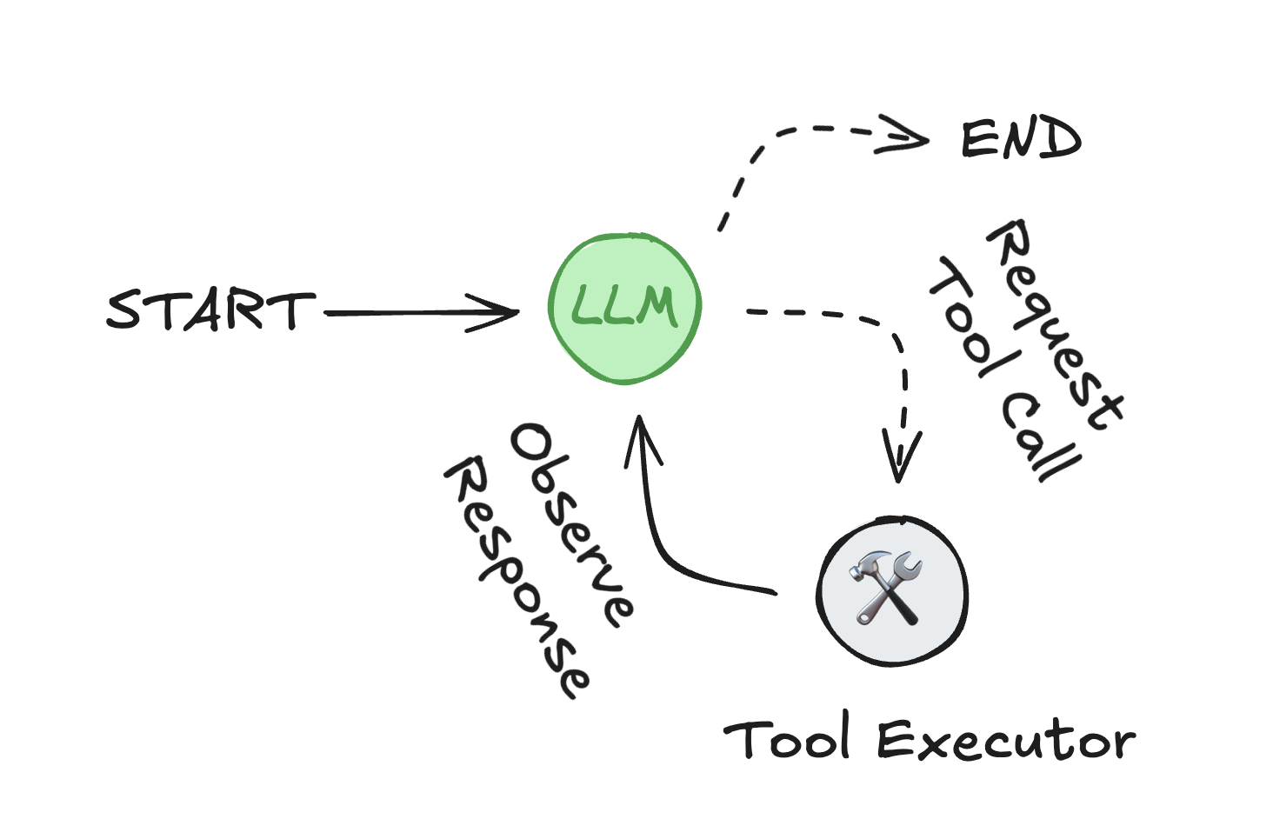
Agentic AI
An agent consists of three components: a large language model (LLM), a set of tools it can use, and a prompt that provides instructions.
https://react-lm.github.io/

Slide 5
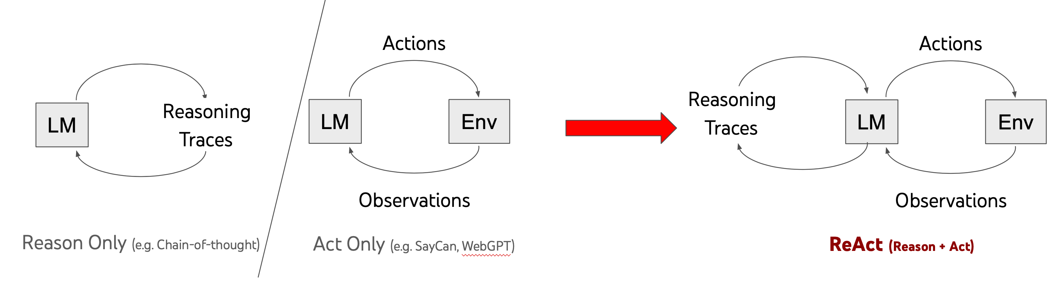
React Prompting
https://react-lm.github.io/

Slide 6
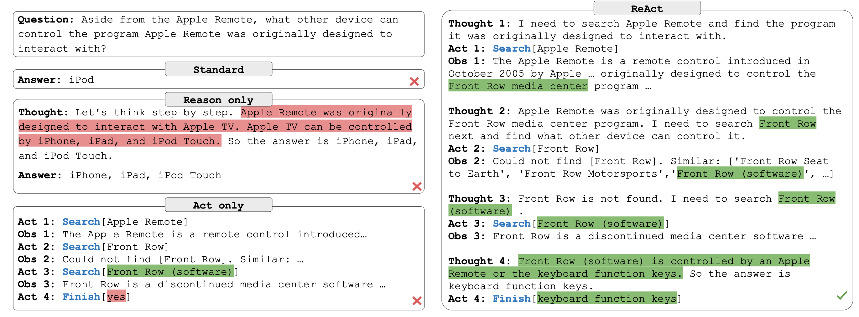
React Prompting

Slide 7
Technologies enabling Agentic AI
Large Language Models (LLMs) with Planning
Extensions like LangChain and AutoGen embed planning modules on top of transformer backbones, enabling multi-step reasoning and tool orchestration.
Reinforcement Learning (RL) & Offline RL
Combining RL with pre-trained models accelerates policy learning in sparse-reward environments (e.g., robotics or game playing).
Multi-Modal Perception
Vision-language models (e.g., CLIP, Flamingo) and sensor fusion techniques provide situational awareness for physical agents and digital assistants.
Hierarchical & Goal-Oriented Architectures
Hierarchical planners break complex objectives into sub-goals, improving scalability and interpretability.
Simulation & Digital Twins
Synthetic environments for safe training and rapid iteration before real-world deployment.

